Slide 1
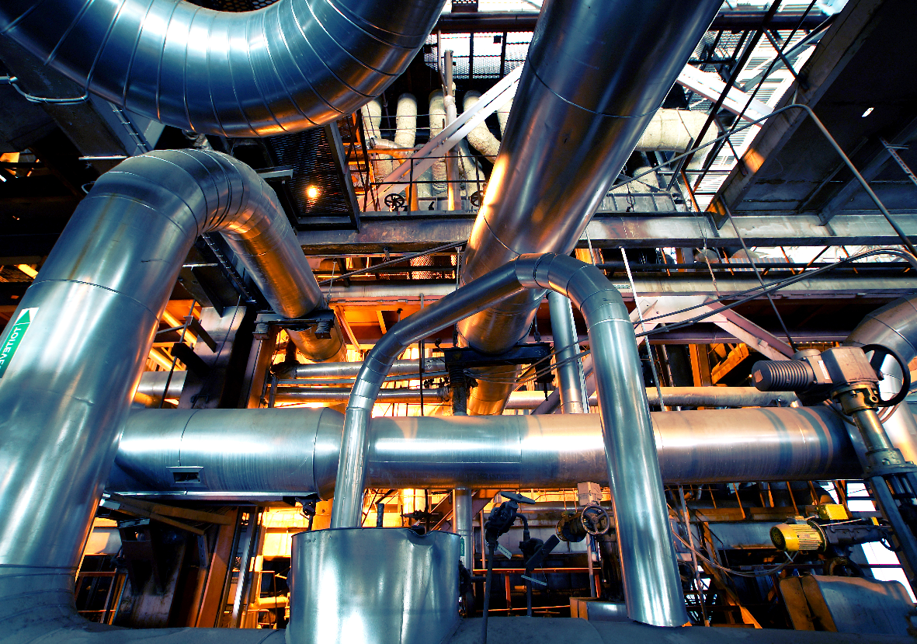
Tax Policy of Viohalco Companies

Slide 2
Tax Policy
About Viohalco
Viohalco S.A. is a Belgium-based holding company of leading metal processing companies across Europe. With production facilities in Greece, Bulgaria, Romania, Russia, FYROM, Turkey, Australia, the United Kingdom and the Netherlands, Viohalco companies specialize in the manufacture and sale of aluminum, copper, cables, steel and steel pipes products, generating annual revenues of € 3.7 billion.
Viohalco companies are committed to sustainable manufacturing of quality, innovative and value added products and solutions for dynamic and promising markets, such as building and construction, energy and telecommunication networks, oil and gas, transportation, marine, automotive, food and pharmaceutical packaging, heating and air conditioning, lithography and numerous other industrial applications.
The Viohalco portfolio also includes a segment dedicated to technology and R&D, comprising companies focused on industrial research and technological development, engineering applications, ERP application services, as well as a segment dedicated to recycling and waste management services.
Viohalco and its companies also own substantial real estate, mainly in Greece, and have implemented redevelopment projects on a number of properties.
Viohalco Key highlights
Manufacturing sites in 9 countries Customers served in more than 105 countries A strong commercial network in 21 countries Global turnover of Euro 3.7 billion in 2017 Listed on Euronext Brussels Exchange (VIO) and on Athens Stock Exchange (BIO) For more information: http://viohalco.com/en/

Slide 3
Tax Policy
Summary of key Tax Principles
In the tax area, Viohalco companies commit to:
Comply with the tax laws and regulations worldwide and act responsively in relation to its tax affairs;
Drive consistent tax behaviors;
Align the global tax policies with sound commercial business activities and rationale; and
Provide the necessary tax advices in order to support its commercial transactions.
In the summary set forth below, we set out the key principles of the Viohalco companies’ tax policy.
Governance
The Viohalco companies observe the tax rules, laws and regulations in all the jurisdictions that they operate in order to meet their tax compliance responsibilities;
Tax governance procedures are further enhanced by the Tax policy handbook, while the companies’ tax organizational model is global, as they always strive to ensure that their tax activities are consistent throughout all of Viohalco companies;
The industries in which the Viohalco companies operate are quite dynamic and as such, the companies keep policies under continuous review and promptly revise them in light of any changes in the tax legislations that could impact Viohalco; and
Viohalco Tax Department’s role is to build and create value for its stakeholders, but always under careful scrutiny of tax laws and regulations.

Slide 4
Tax Policy
Risk management
Viohalco companies policy and approach towards risk management is defined clearly throughout the business. In particular, the companies try to ensure that all of their personnel, whose daily business may have a tax impact, coherently understands, identifies and reports various tax risks; and
Viohalco companies are highly respected amongst both their customer base and the market as a whole and as such, they do not take positions that could jeopardize their good and long-standing reputation.
Key roles and responsibilities
Tax is part of the Viohalco’s finance function and within the wide responsibilities of the Viohalco’s Chief Finance Officer;
The personnel is constantly trained in order to broaden both its technical background and soft skills, which will help them manage their tax responsibilities in a more efficient way. In general, Viohalco companies continuously invest in developing talented professionals, who will remain challenged and eager about their role and responsibilities; and
As tax matters are of significant importance, the plan is to form a Tax Excellence Center in the near future, in which professionals from all around the world will contribute with their knowledge and their technical tax expertise.

Slide 5
Tax Policy
Viohalco companies’ attitude towards tax planning
The Viohalco companies make sure that any corporate restructuring has commercial and economic substance, while extra care is given in order to ensure that all business decisions are fairly documented and well-considered taxwise;
Viohalco companies’ tax strategy is evaluated through a calculated risk model given the scale of their business. In this respect, they actively seek to identify, evaluate, monitor and manage the risks they may face. In addition, due to the volume and complexity of tax laws and regulations being published every day worldwide, external advice is sought particularly in relation to their international tax obligations in order to mitigate such risks; and
In structuring the companies’ commercial activities, they always consider the tax laws of the respective countries they operate, having always the view on providing added value to their business, stakeholders and the countries hosting them.
Viohalco companies’ approach towards their dealings with HMRC
Viohalco companies’ relationship, not only with HMRC, but with all the tax authorities around the globe, is consistent, open and transparent. In this respect, the companies work with various tax authorities positively and to the extent that it is feasible, proactively in order to minimize the extent of disputes. In any case, part of the plan is to achieve certainty and as such, companies try to conclude with tax authorities Advanced Pricing Agreements and other tax rulings; and
Part of Viohalco companies’ policy is the disclosure of any information needed in order to facilitate the tax authorities’ queries.

